Slide 1



KARL: Fast Kernel Aggregation Queries
Authors: (Edison) Tsz Nam Chan^{1,2}, Man Lung Yiu² and Leong Hou U³
1: The University of Hong Kong
2: Hong Kong Polytechnic University
3: University of Macau
(Presented by: Edison)

Slide 2
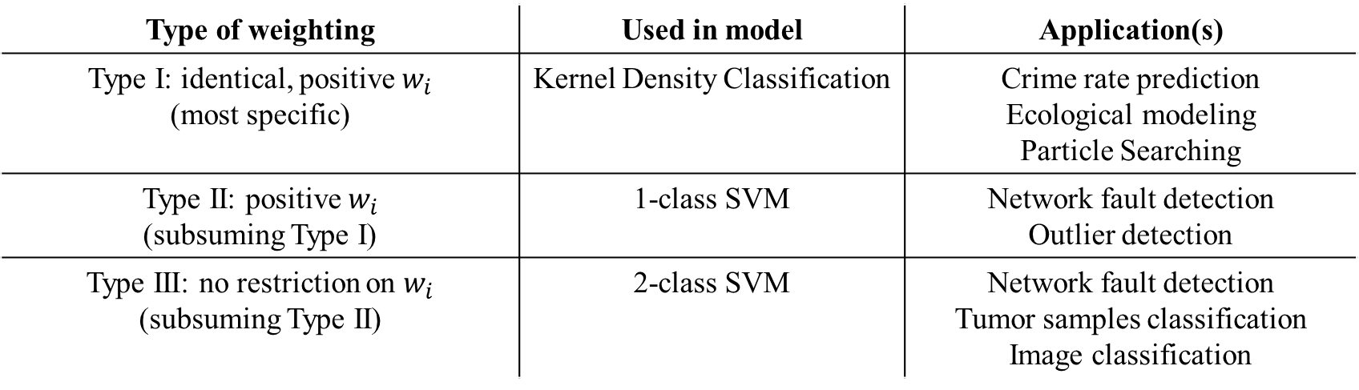
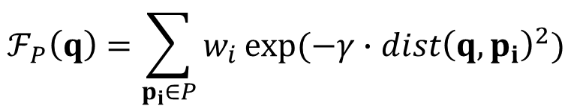
Kernel Aggregation Function and Machine learning Models
query
weighting
Euclidean distance
Kernel aggregation function:
$$ℱ_{P}\left(q\right)=\sum_{p_{i}∈P}{w_{i}}exp⁡(−γ∙{dist\left(q,p_{i}\right)}^{2})$$
dataset
constant
Type of weighting | Used in model | Application(s)
Type I: identical, positive $w_{i}$ (most specific) | Kernel Density Classification | Crime rate prediction Ecological modeling Particle Searching
Type II: positive $w_{i}$ (subsuming Type I) | 1-class SVM | Network fault detection Outlier detection
Type III: no restriction on $w_{i}$ (subsuming Type II) | 2-class SVM | Network fault detection Tumor samples classification Image classification

Slide 3
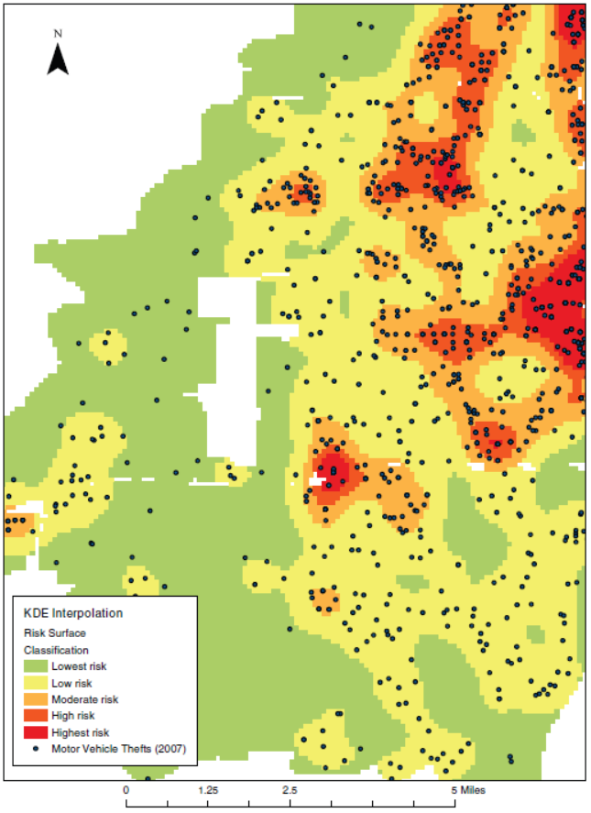

Kernel Density Classification
Black dots (Crimes)
Aggravated assault
Robbery
Commercial burglary
motor vehicle theft
Regions:
Crime rates prediction
How to generate color?
$$ℱ_{P}\left(q\right)$$
T. Hart and P. Zandbergen “Kernel density estimation and hotspot mapping Examining the influence of interpolation method, grid cell size, and bandwidth on crime forecasting”, International Journal of Police Strategies and Management 2014

Slide 4


Kernel Support Vector Machine Classification
User 5
Classify
User 4
$$ℱ_{P}\left(q\right)≤τ$$
Anomaly
Class
Signal
$$ℱ_{P}\left(q\right)>τ$$
Server
Normal
Class
User 1
User 2
User 3
A. L. Buczak and E. Guven. A survey of data mining and machine learning methods for cyber security intrusion detection. IEEE Communications Surveys and Tutorials, 2016.

Slide 5
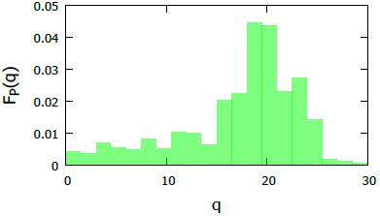
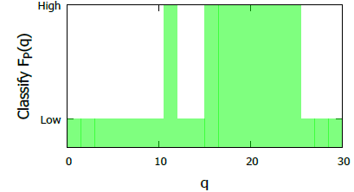
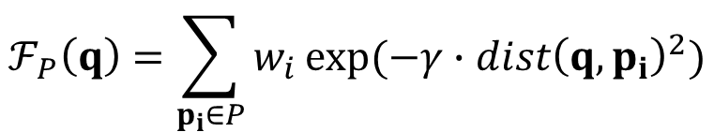
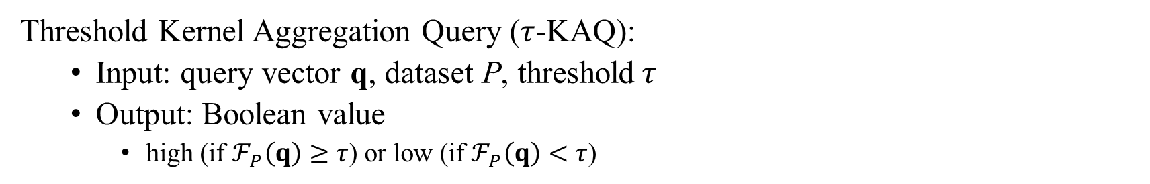
Kernel Aggregation Queries (KAQ)
$$ℱ_{P}\left(q\right)=\sum_{p_{i}∈P}{w_{i}}exp⁡(−γ{∙dist\left(q,p_{i}\right)}^{2})$$
Kernel aggregation function:
Threshold Kernel Aggregation Query ($τ$-KAQ):
Input: query vector q, dataset P, threshold$τ$
Output: Boolean value
high (if $ℱ_{P}\left(q\right)≥τ$) or low (if $ℱ_{P}\left(q\right)<τ$)
KAQ
τ-KAQ, τ=0.01

Slide 6
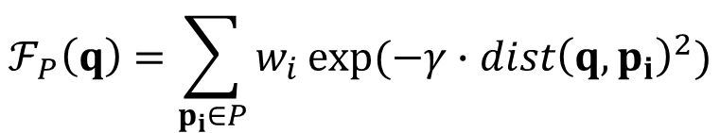
Kernel Aggregation Queries are slow!
Le et al. “Despite their successes, what makes kernel methods difficult to use in many large scale problems is the fact that computing the decision function is typically expensive, especially at prediction time.” [1]
$$ℱ_{P}\left(q\right)=\sum_{p_{i}∈P}{w_{i}}exp⁡(−γ{∙dist\left(q,p_{i}\right)}^{2})$$
How large are |P| and d?
O(|P| × d) time
[1] Quoc V. Le, Tamas Sarlos, and Alexander J. Smola. “Fastfood- computing hilbert space expansions in loglinear time.” In ICML2013

Slide 7
Our contribution: KARL
Kernel Aggregation Rapid Library (KARL)
2.5-738x speed up over state-of-the-art in different datasets
The Fastest library in online prediction phase
Library | Support indexing | Response time
LibSVM | no | high
Scikit-learn | yes | high
KARL (this paper) | yes | low
KARL: https://github.com/edisonchan2013928/KARL-Fast-Kernel-Aggregation-Queries
LibSVM: https://www.csie.ntu.edu.tw/~cjlin/libsvm/
Scikit-learn: https://scikit-learn.org/

Slide 8
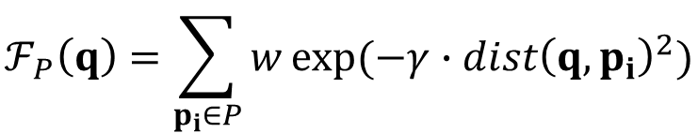




How to speed up?
$$ℱ_{P}\left(q\right)=\sum_{p_{i}∈P}{w}exp⁡(−γ∙{dist\left(q,p_{i}\right)}^{2})$$
Conditions for avoiding $ℱ_{P}\left(q\right)$ evaluation:
Case 1 ($ℱ_{P}\left(q\right)≥\text{τ}$):
Case 2 ($ℱ_{P}\left(q\right)<\text{τ}$):
UB(q)
τ
$$LB\left(q\right)≤ℱ_{P}\left(q\right)≤UB(q)$$
UB(q)
LB(q)
τ
LB(q)
Much faster than O(|P| × d) time
Should be tight

Slide 9
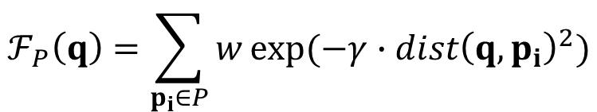
Existing Work: Bounding Functions
Example: |P|=3
R
$$ℱ_{P}\left(q\right)=\sum_{p_{i}∈P}{w}exp⁡(−γ∙{dist\left(q,p_{i}\right)}^{2})$$
maxdist(q,R)
$${LB}_{R}\left(q\right)=w∙R.count∙exp⁡(−γ{∙maxdist\left(q,R\right)}^{2})$$
q
mindist(q,R)
$${UB}_{R}\left(q\right)=w∙R.count∙exp⁡(−γ{∙mindist\left(q,R\right)}^{2})$$
O(d) time
[1] E. Gan and P. Bailis. "Scalable kernel density classification via threshold based pruning" SIGMOD2017
[2] A. G. Gray, A. W. Moore “Nonparametric Density Estimation: Toward Computational Tractability” SDM03

Slide 10
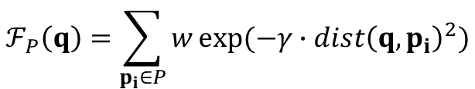
Weakness of Existing Bound Functions
$$ℱ_{P}\left(q\right)=\sum_{p_{i}∈P}{w}exp⁡(−γ{∙dist\left(q,p_{i}\right)}^{2})$$
x_{i}
$${LB}_{R}\left(q\right)=w∙R.count∙exp⁡(−γ{∙maxdist\left(q,R\right)}^{2})$$
x_{max}
x_{min}
x₁
x₂
Too loose
x₃
x_{max}
function
exp(–x)
Research Question 1:
Can we develop the tighter lower bound function?
existing bound:
exp(-x_{max})

Slide 11
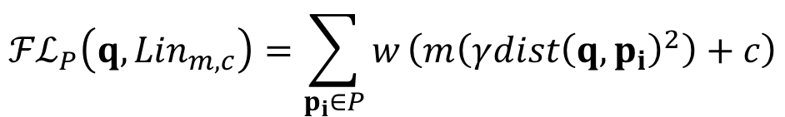
Our Work: Tangent Bound
$$ℱ_{P}\left(q\right)=\sum_{p_{i}∈P}{w}exp⁡(−γ{∙dist\left(q,p_{i}\right)}^{2})$$
x_{i}
$${LB}_{R}\left(q\right)=w∙R.count∙exp⁡(−γ{∙maxdist\left(q,R\right)}^{2})$$
x_{max}
Tangent Bound:
x_{min}
$${ℱℒ}_{P}\left(q,{Lin}_{m,c}\right)=\sum_{p_{i}∈P}{w}\left(m\left(γ{dist\left(q,p_{i}\right)}^{2}\right)+c\right)$$
the tangent line (at x_{max}):
E^{L}(x) = mx + c
x₁
x_{i}
x₂
x₃
x_{max}
function
exp(–x)
Research Question 2:
How to compute this tighter bound quickly?
existing bound:
exp(-x_{max})

Slide 12
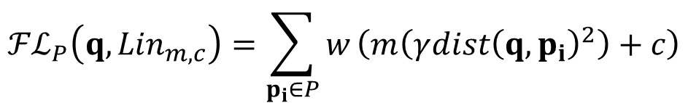
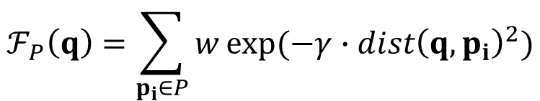
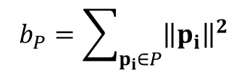
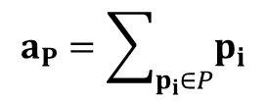
O(d)-time Tighter Linear Bound
$$ℱ_{P}\left(q\right)=\sum_{p_{i}∈P}{w}exp⁡(−γ{∙dist\left(q,p_{i}\right)}^{2})$$
Tightness
Exact
x_{i}
Linear bound of $ℱ_{P}\left(q\right)$:
$${ℱℒ}_{P}\left(q,{Lin}_{m,c}\right)=\sum_{p_{i}∈P}{w}\left(m\left(γ{dist\left(q,p_{i}\right)}^{2}\right)+c\right)$$
Ours
x_{i}
Existing bounds
$${ℱℒ}_{P}\left(q,{Lin}_{m,c}\right)=wmγ\left(\left|P\right|{\left\|q\right\|}^{2}−2q∙a_{P}+b_{P}\right)+wc|P|$$
Time
O(d)
O(|P|d)
O(d)
O(d)
where
$$a_{P}=\sum_{p_{i}∈P}{p_{i}}$$
and
$$b_{P}=\sum_{p_{i}∈P}{{\left\|p_{i}\right\|}^{2}}$$

Slide 13
Advanced Version: Optimized Tangent Bounds
x_{min}
x₁
x₂
x₃
x_{max}
function
exp(–x)
optimized tangent line (at t):
E^{L}(x)=mx + c
Finding the optimized tangent line is also in O(d) time.

Slide 14
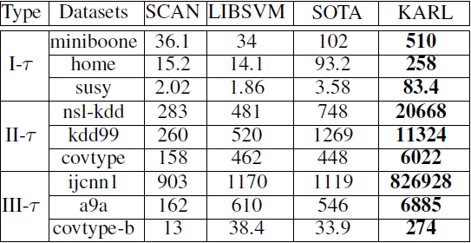
Experimental Results
Methods: SCAN (baseline), LIBSVM, SOTA and KARL
Datasets: UCI Machine Learning Repository/ LibSVM website
Throughput (Queries/sec)
SOTA: E. Gan and P. Bailis. "Scalable kernel density classification via threshold based pruning" SIGMOD2017

Slide 15
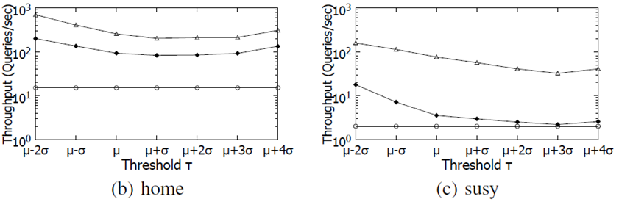
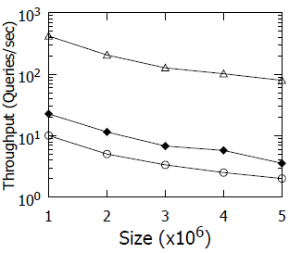
Scalability Experiments (in Type I-τ)
Vary seven thresholds
Vary data size in dataset susy

Slide 16
Conclusion and Future Work
What we have done:
Develop Kernel Aggregation Rapid Library (KARL)
Support a wide range of models (in prediction stage)
Kernel Density Classification
One Class SVM
Two Class SVM
Achieve higher throughput than the state-of-the-art by 2.5-738x times
Future Work:
Integrate the implementation into the library (Ongoing)
Support different types of machine learning models (Ongoing)
Support different types of kernel functions (Ongoing)
Support interesting applications, e.g., Kernel Density Visualization (Ongoing)

